Slide 1
Week 23

Slide 2
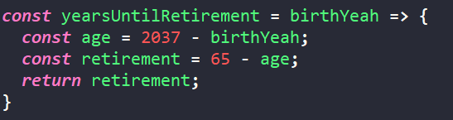
Arrow function
So since we want to use the result value of the function, we can store it in a variable:
This is the simplest form of it.
Complicated would look like this:
There could be many input parameters instead of just one

Slide 3
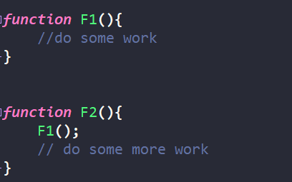
Function within the function
One function calling another
For example we want to describe the food processing:
First, we want to cut food into smaller pieces
Then we want to process those small food pieces
As result we get some juice

Slide 4
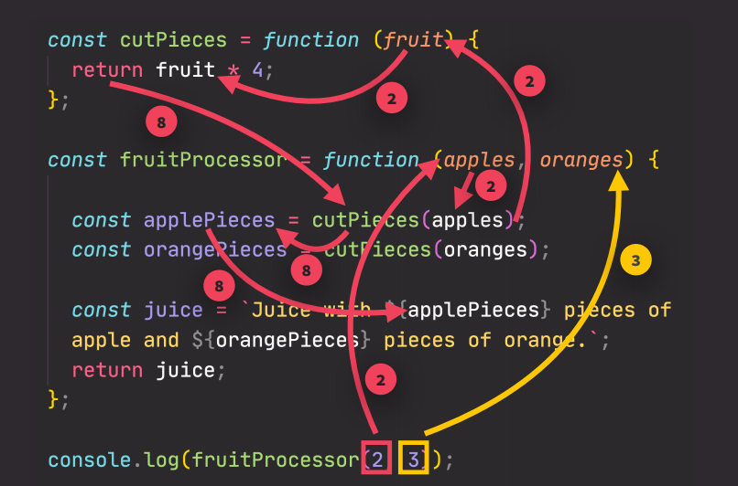
Function called within a function

Slide 5
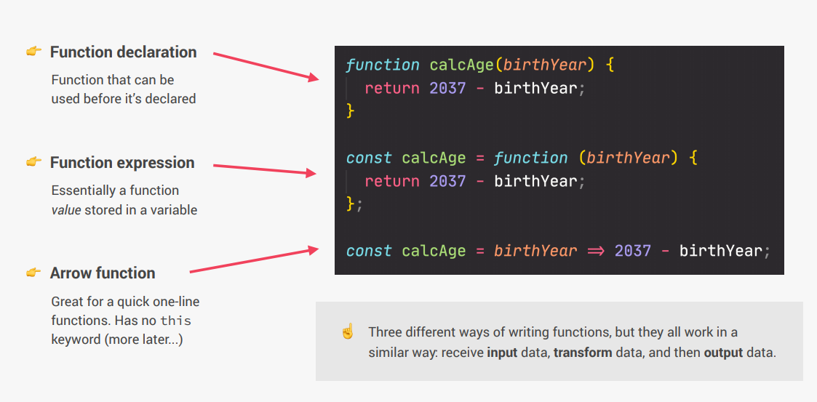
Functions review

Slide 6
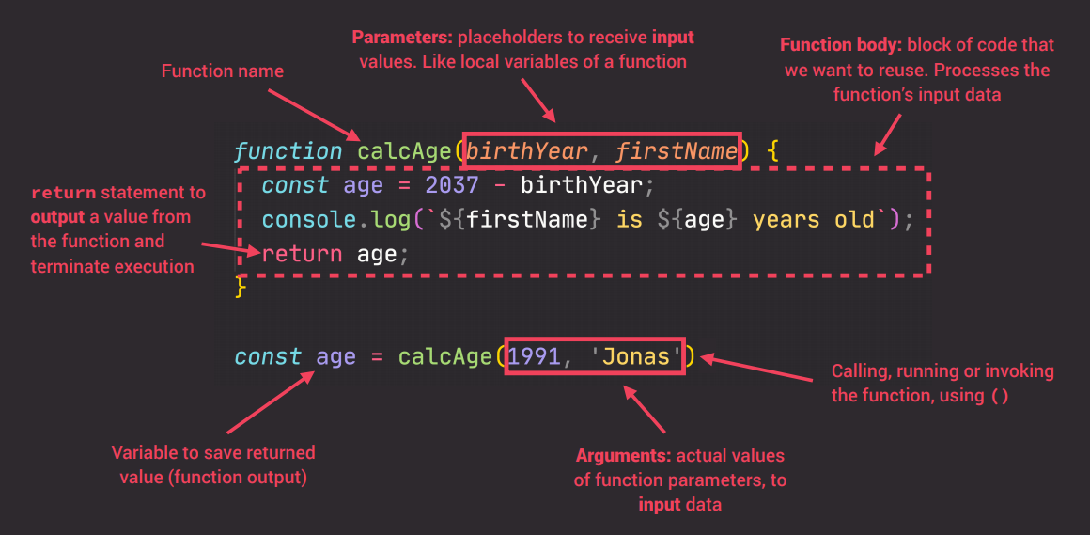
Functions review

Slide 7
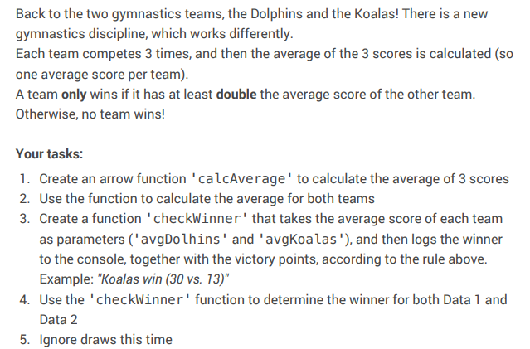
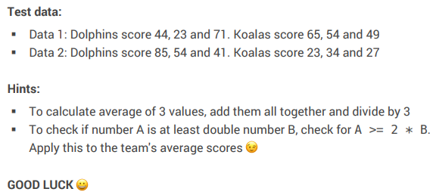
Code challenge 1

Slide 8
Arrays
If we want to make collection of data (many of the same type) then we use array
Fortunately arrays in JS are somewhat similar to those of C++ and C#
To access any particular member of the array we need to use indexes:
friends[0] or friends[1] or friends[2]
NOTE: Indexes start from 0!

Slide 9




Array operations (methods)
After practicing a bit let’s see the basic operations for arrays
Add element to the end of array:
Remove last element:
Add element at the beginning of array:
Remove first element:

Slide 10
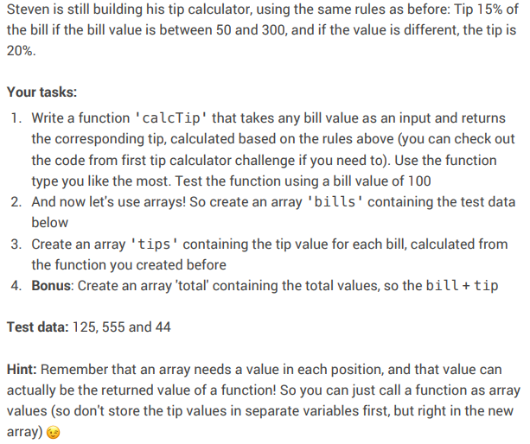
Coding challenge 2

Slide 11
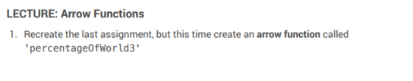
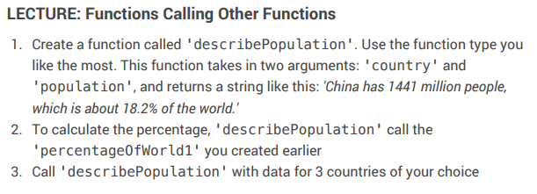
Homework - 1

Slide 12
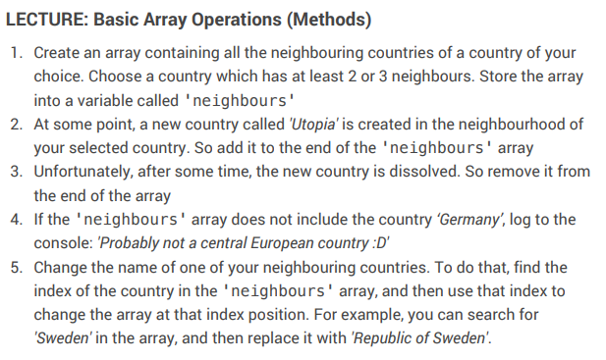
Homework 2

